Slide 1
Hash Tables Collisions
Kurt Friedrich
Spring 2018
Good video https://www.youtube.com/watch?v=h2d9b_nEzoA

Slide 2
Hash Table Collisions
Trade off between larger hash tables, and more complicated hash algorithms to minimize collisions, and small tables with faster algorithms that incur more collisions.
As they get bigger/slower, the wasted memory space and the lookup time savings starts to slip away
And every algorithm that maps a large possible space into a smaller space must deal with a collision, even if the probability is quite small.
So then how can we deal with collisions?
We will look at 2 ways, chaining and linear probing

Slide 3
Chaining to resolve Collisions
Rather than a simple table, use an array of linked lists
keys that hash to the same value then stored uniquely in a linked list
LL holds object with a key prop and a value prop
0
null
1
LL
K=3 V=“VP”
2
LL
K=7 V=“SecA ”
K=9 V=“SecF”
3
null
4
LL
K=12 V=“SecC”
5
LL
K=13 V=“SecB”
6
LL
K=1 V=“SecK”
K=19 V=“Attn”
K=6 V=“Pres”
7
LL
K=14 V=“SecG”
8
null
…

Slide 4
Hash table of linked lists
To insert a key K and value
Create a “item” object and set its 2 properties with K and value
Compute h(K) to determine which list to traverse
If that array element contains a null, instantiate a new LL there, and add the new “item” object to the new linked list.
If that array element already has a LL, just add the new “item” at the beginning of this list.
This will be O(1)
To find a value (or delete), compute h(K) to pick the list, and then walk the list until you find an object with a prop key that matches the original key, not the hash(key), and then return the value string (or delete the node).
This will be O(1) + O(n) where n is the length of the LL. Assuming a good distribution algorithm, the LLs will be quite short, so we are really still close to O(1)

Slide 5
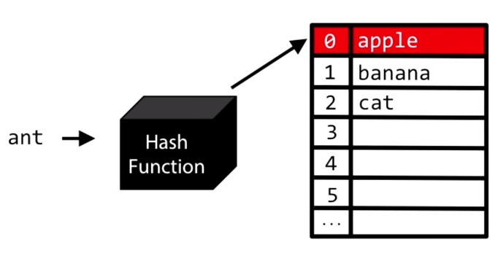
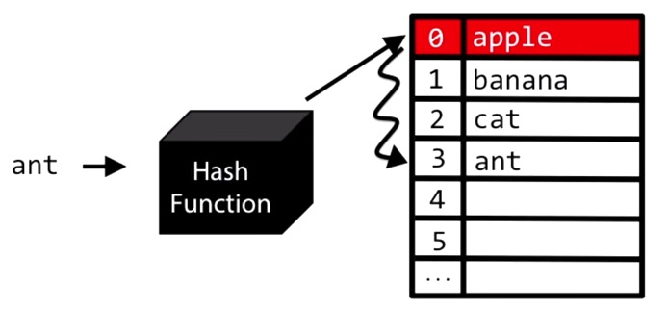
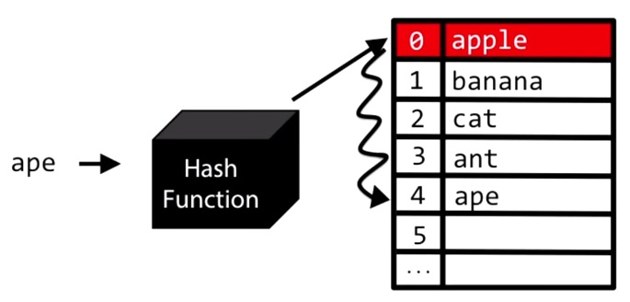
Linear Probing to resolve Collisions
If a key hashes to a slot that is already used, you move down the list to find the next available empty slot. (including wraparound)
Can’t just delete an entry, have to mark it as “was in use before”!
def
def
def
def
def
def
def
def
def
def
def
def
To retrieve
Because of the collision resolution, the target data might reside at a location other than the element referred to by the hash code.
Use the hash to start search, the find an exact match between key and strored key, or an empty hash element is found.
def
def
def
def
def
def
def
def
def

Slide 6
Linear Probing to resolve Collisions
Each time you have a collision, you increase the chances of getting another collision in the same areas, and this is called “clustering”.
Instead if insertion or lookup being O(1), it is now tending towards O(n) as the table gets full.
The tradeoffs for Chaining and Linear Probing
For successful searches, the simple method linear probing is not so bad if the table is not almost full. Much less overhead as you don’t have a bunch of linked lists.
Especially if the table is storing small chunks of data, as then the LL is using much more memory
For unsuccessful searches, clustering quickly causes linear probing to degenerate into a long sequential search.

Slide 7
There are more ways
There is “quadratic probing” where instead of just moving to the next empty slot, you use a math function, with the hope of avoiding large cluster problems
There is double hashing, and more …
We are going to move on and look at some common hashing algorithms.

